Slide 1
City Pulse Traffic IoT Dataset Analysis
Team 13
Anirudh Kuttiyil Valsalan
Febin Steve Jose
Malini Kottarappatt Bhaskaran
Nipun Agarwal
Niraj Gadakari

Slide 2
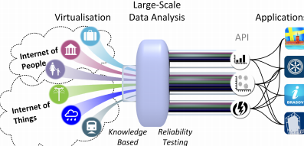
Overview
Smart City IoT Dataset
City: Aarhus, Denmark
Sources of Data
Archived data
-> Traffic
-> Pollution
-> Weather
Streaming Data
-> Real time traffic information

Slide 3
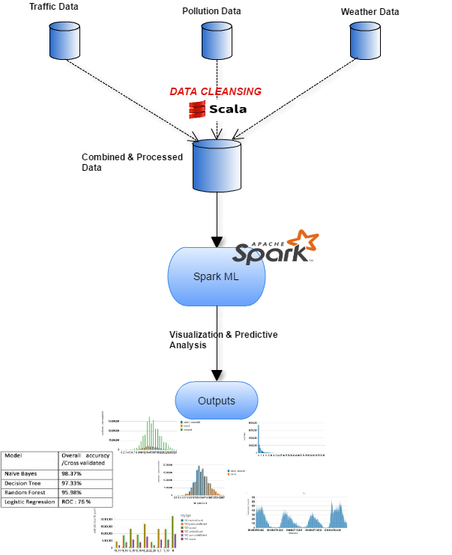
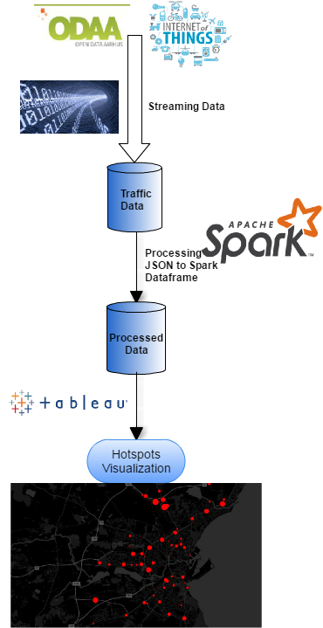
Analysis Process & Tools

Slide 4
Work Flow Archival Data
Data Cleansing
Creation of Dataframes
Pollution
Traffic
Weather
Traffic MetaData
Combined the data frames to create the fully processed data frame for ML algorithms
Plotted the relationships for statistical study

Slide 5
Work Flow Real time Streaming Data
Developed a streaming framework for the real time traffic data analysis
Technologies used :
PySpark for converting from JSON string to JSON object
Panda API to convert JSON object Panda Data frame
Converted Pandas data frame to spark data frame
Used Tableau for map visualization with traffic hotspots

Slide 6
ML Algorithms for Prediction
Technologies used :
Scala for Data processing
PySpark for applying ML algorithms
Tensor flow
Process :
Converted the continuous attributes to discrete
Introduced new attributes dayType and daytime
Introduced label with traffic status as binary
Build models using following algorithms:
Logistic Regression
Random Forest
Decision Tree
Naïve Bayes
Used cross validation to avoid overfitting

Slide 7
ML Results / Spark ML
Actual/ Prediction | 0 | 1
0 | 285773 | 12366
1 | 2298 | 264
Actual/ Prediction | 0 | 1
0 | 297780 | 359
1 | 1839 | 723
Naïve Bayes
Random Forest
Model | Overall accuracy / Cross validated
Naïve Bayes | 98.37%
Decision Tree | 97.33%
Random Forest | 95.98%
Logistic Regression | ROC : 76 %

Slide 8
ML Algorithm using TensorFlow
Developed convolution neural network to classify the Traffic status
Features: location (i.e. latitude, and longitude), type of the day (i.e. weekday or weekend), and weather data at that particular location.
The accuracy achieved for predicting the traffic status to be "OK" or "NOT OK" was 98.5%

Slide 9
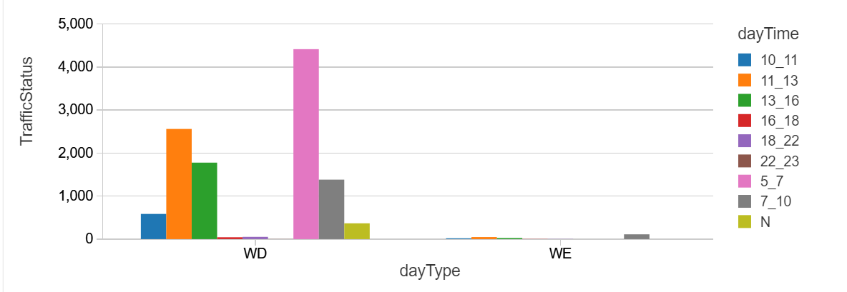
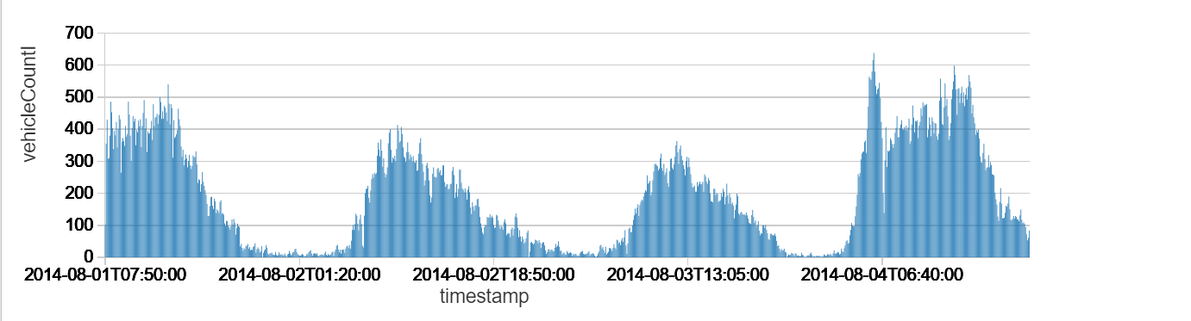
Statistical Analysis – Result plots
Traffic Status VS Day type
Vehicle count VS Time stamp

Slide 10
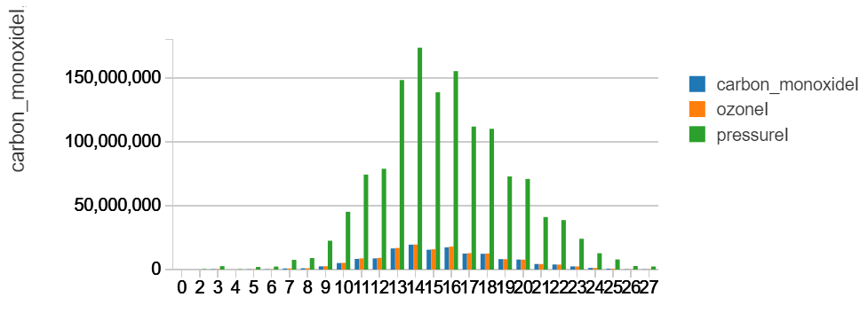
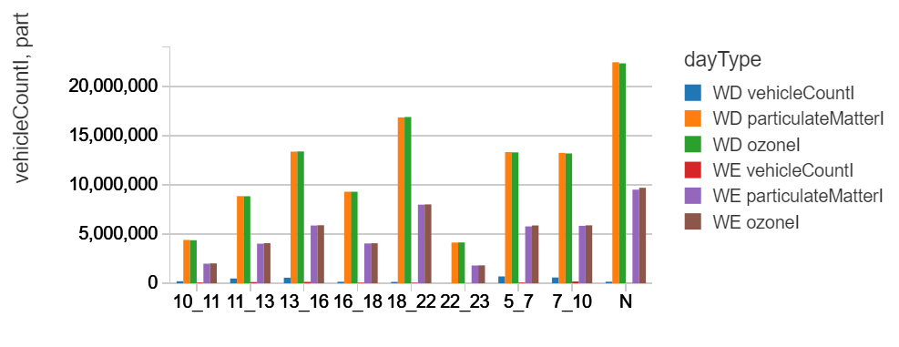
Statistical Analysis – Result plots
Pollutants Vs Temperature
Vehicle Count, Pollutants Vs daytime (Grouped by Day type)

Slide 11
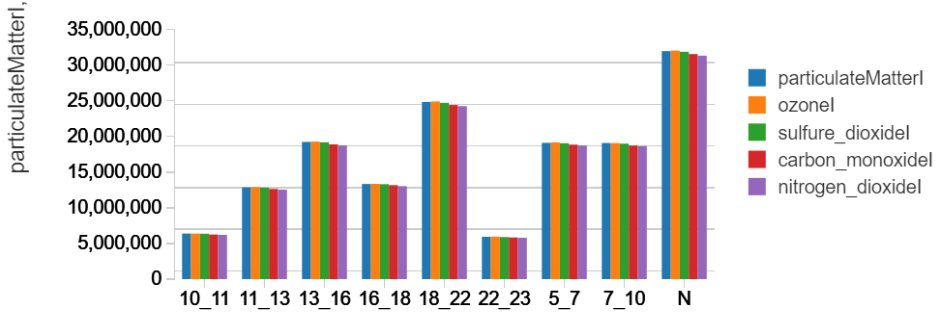
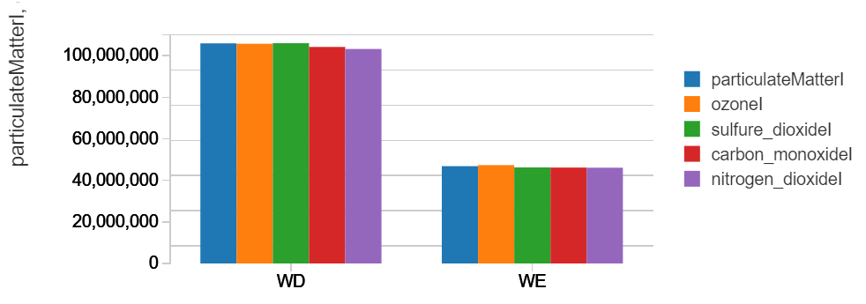
Statistical Analysis – Result plots
Pollutants VS Day Time
Pollutants Vs DayType

Slide 12
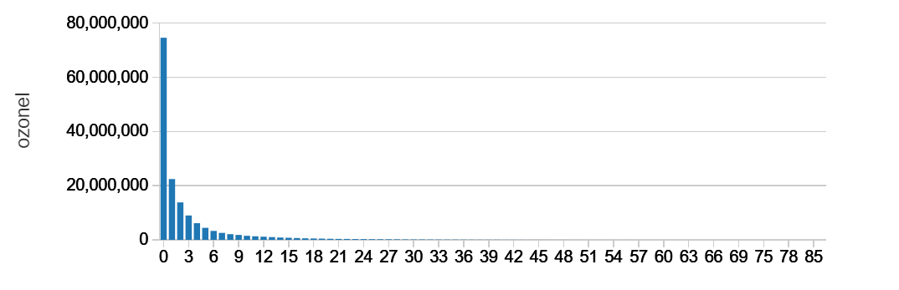
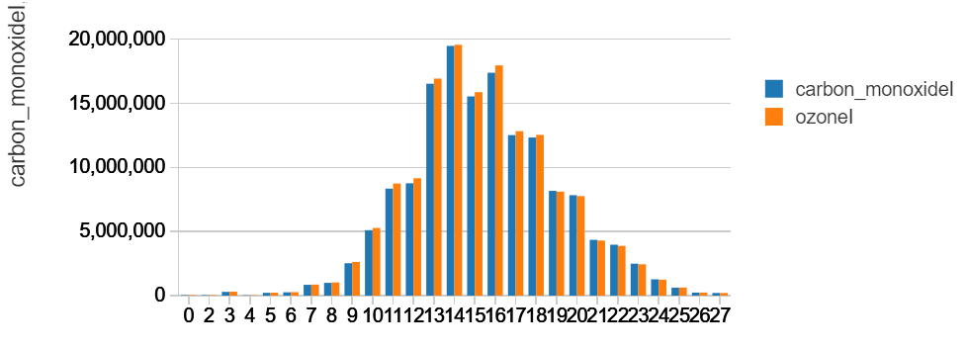
Statistical Analysis – Result plots
Ozone Vs Vehicle Count
Temperature
CO, O3 Vs Temperature

Slide 13
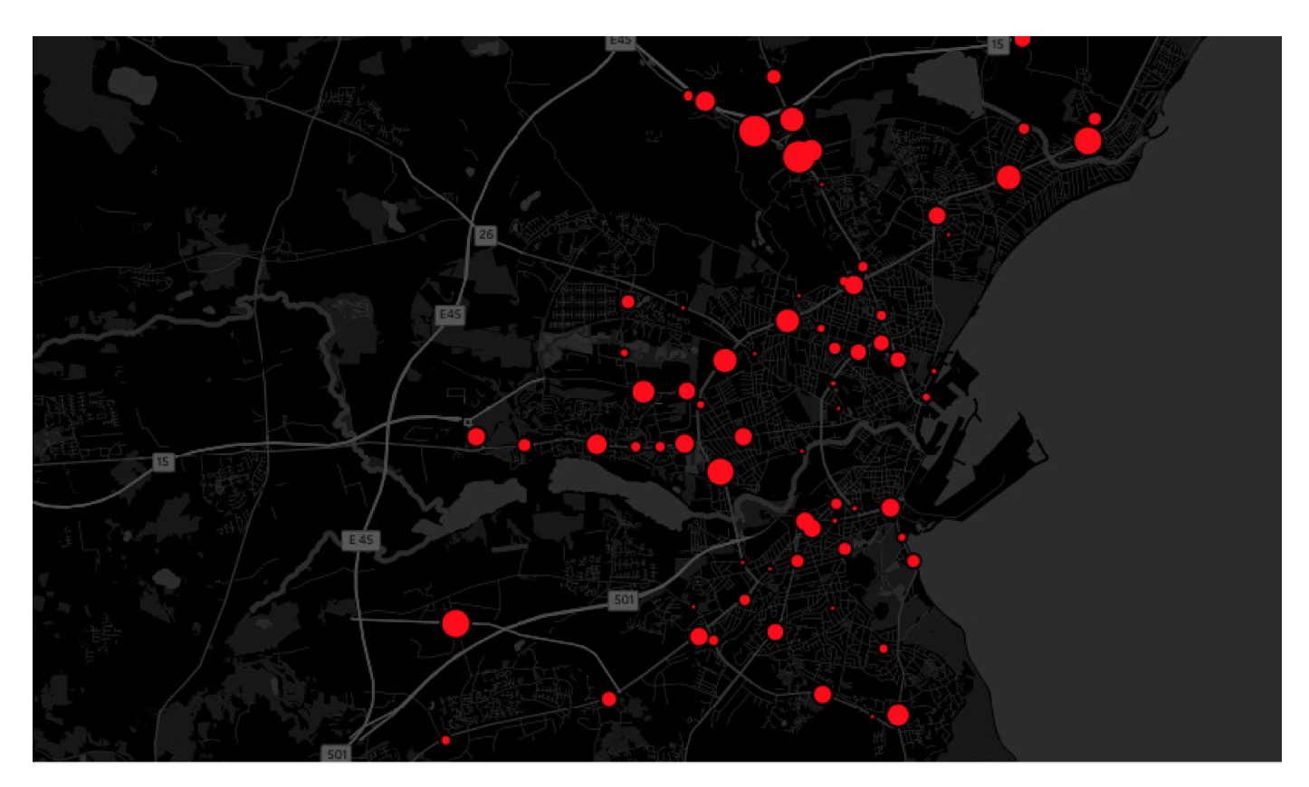
Identified Traffic Hot Spot
Various traffic hotspots as shown in red for the city of Aarhus plotted using Tableau[9]

Slide 14
Challenges Faced
Weather Data was in JSON format
Report ID was not present in pollution
Null values were present
Timestamp were not in the same format in all files
Needed to extrapolate the weather data to 5 minute interval
Pre-Processing and data cleansing took more time
Databricks community cloud edition doesn’t allow to download the processed file to local computer via code

Slide 15
References
[1] Muhammad Intizar Ali, Feng Gao and Alessandra Mileo CityBench: A Configurable Benchmark to Evaluate RSP Engines Using Smart City Datasets, In proceedings of ISWC 2015 - 14th International Semantic Web ConferenceBethlehem, PA, USA.
[2] Srini Penchikala Big Data Processing with Apache Spark - Part 4: Spark Machine Learning https://www.infoq.com/articles/apache-spark-machine-learning
[3] Juliet Hougland and Sandy Ryza How-to: Predict Telco Churn with Apache Spark MLlib https://blog.cloudera.com/blog/2016/02/how-to-predict-telco-churn-with- apache-spark-mllib/
[4] Bill Haffey Predictive Analytics and Machine Learning: An Overview https://www-01.ibm.com/events/wwe/grp/grp004.nsf/vLookupPDFs
[5] Spark MLlib http://spark.apache.org/mllib/
[6] Real-Time Traffic Data https://www.odaa.dk/dataset/realtids-trafikdata/resource/b3eeb0ff-c8a8- 4824-99d6-e0a3747c8b0d
[7] TensorFlow https://www.tensorflow.org/
[8] Payam Barnaghi, Ralf Tonjes et. al. CityPulse: Real-Time IoT Stream Processing and Large-scale Data Analytics for Smart City Applications, poster session, European Conference on Networks and Communications. 2014.
[9] Tableau https://www.tableau.com/stories/topic/maps
[10] R.Tnjes,P.Barnaghi,M.Aliet.al.RealTimeIoTStreamProcessingand Large-scale Data Analytics for Smart City Applications, poster session, European Conference on Networks and Communications 2014
[11] Kolozali, Sefki, et al.A knowledge-based approach for real-time IoT data stream annotation and processing.Internet of Things (iThings), 2014 IEEE International Conference on, and Green Computing and Communications (GreenCom), IEEE and Cyber, Physical and Social Computing (CPSCom), IEEE. IEEE, 2014.
[12] IoT https://www.wired.com/insights/2014/11/the-internet-of-things-bigger/
[13] Barnaghi, Payam, Amit Sheth, and Cory Henson. From Data to Ac- tionable Knowledge: Big Data Challenges in the Web of Things [Guest Editors’ Introduction].IEEE Intelligent Systems 28.6 (2013): 6-11.

